Slide 1
Aradon…
void main(String[] args) to Service

Slide 2

Aradon?

Slide 3
Aradon!
Flexible
Structure
Service Platform
Rest

Slide 4
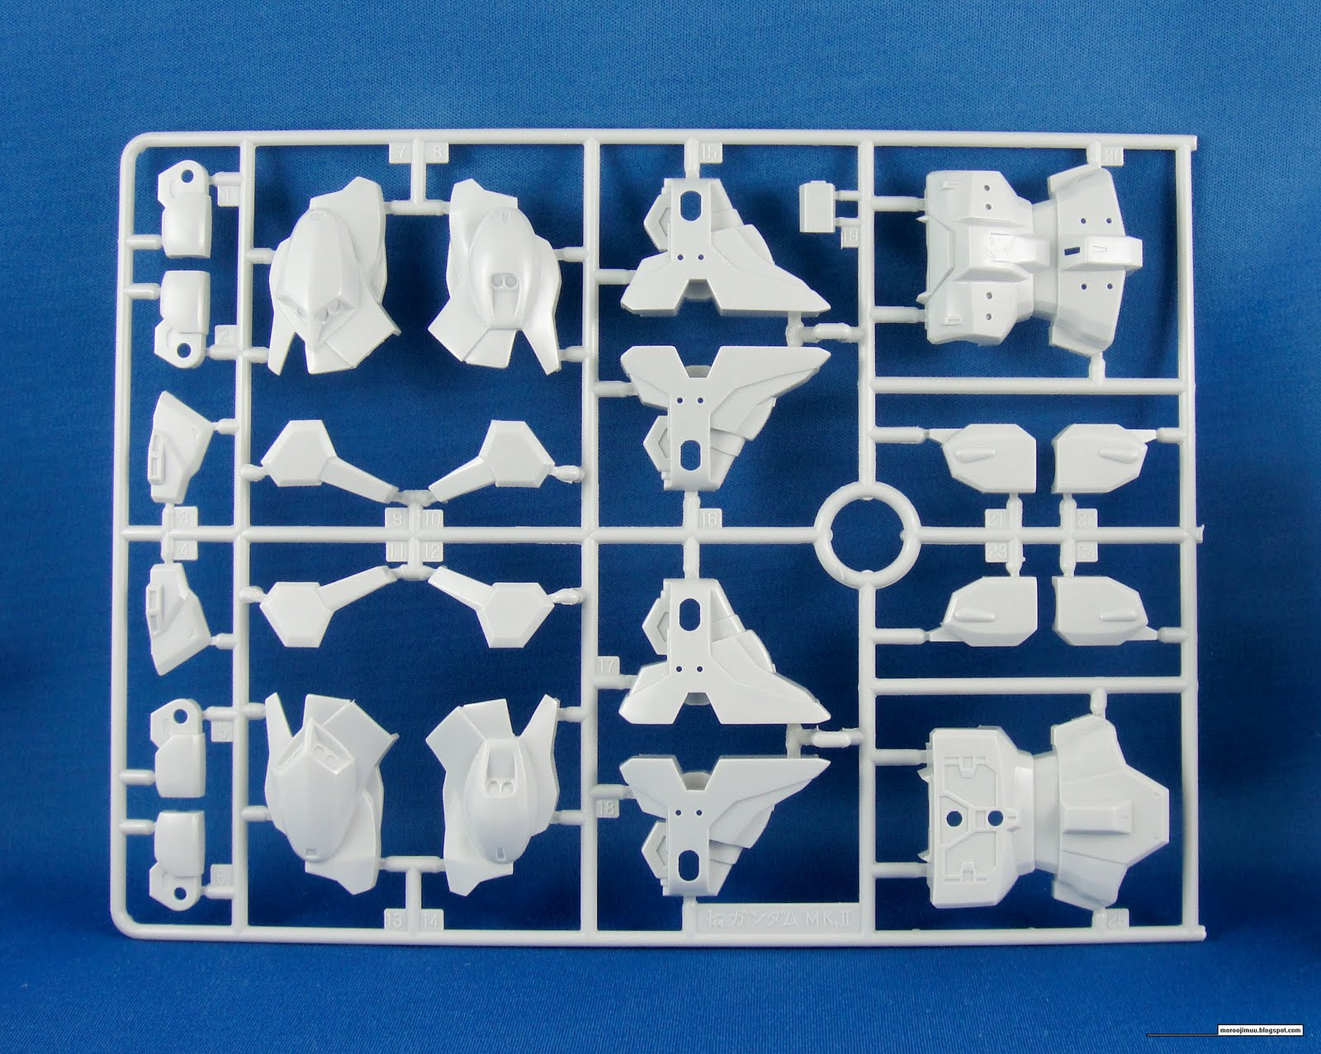
Object, Library, Module

Slide 5

Just make a part

Slide 6
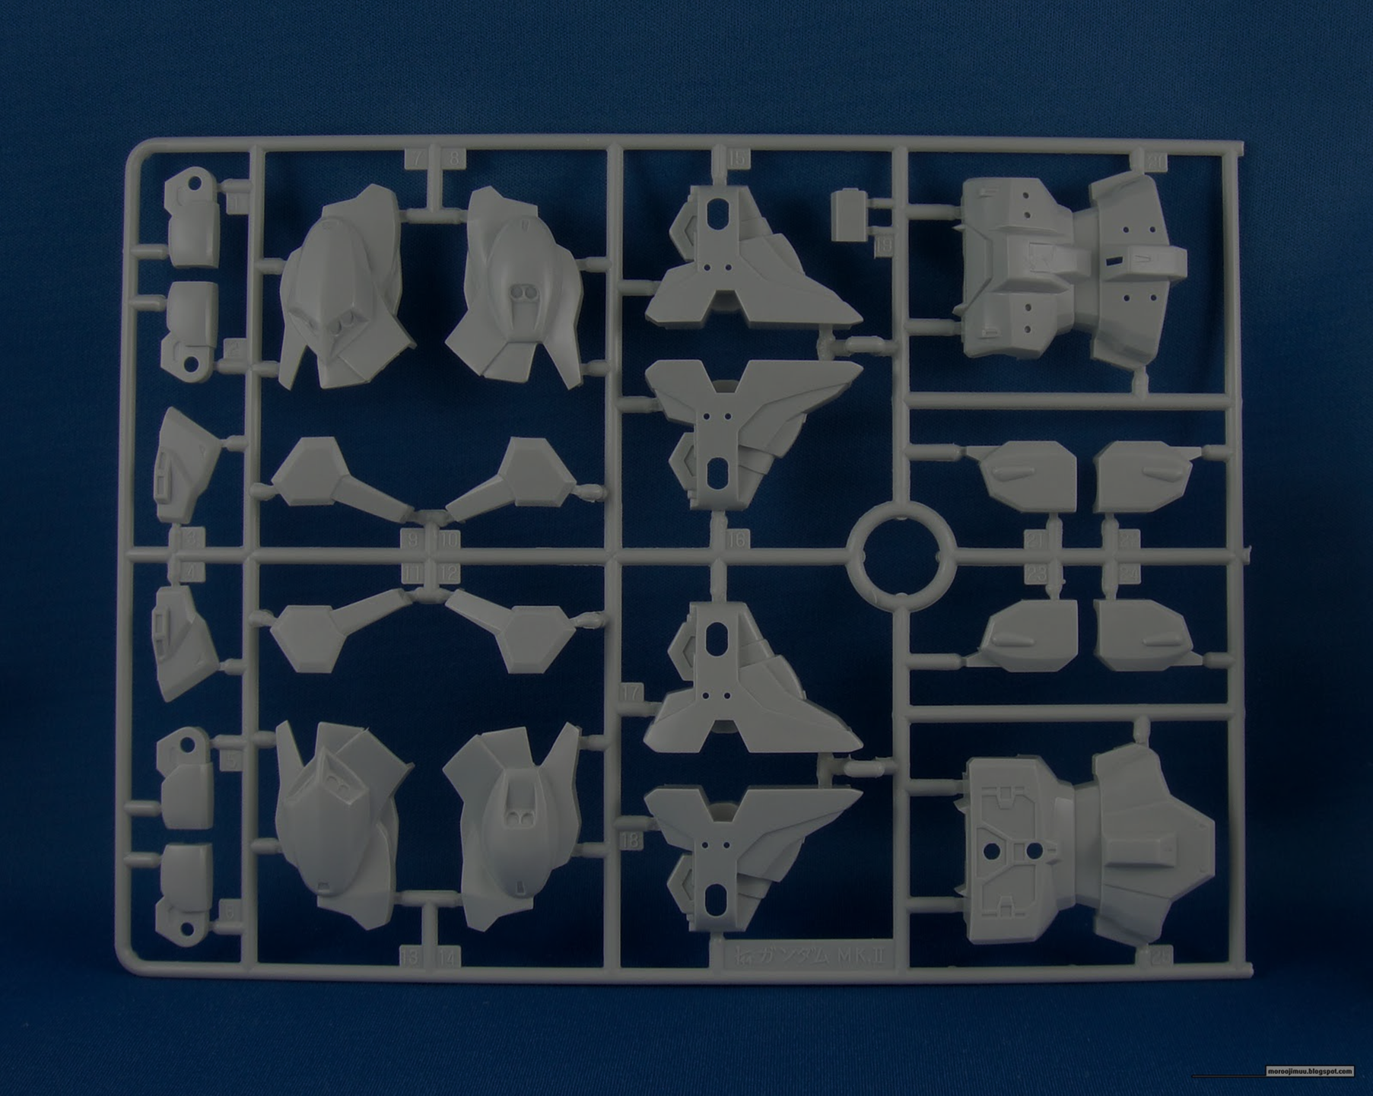

Just make a part
Source code
Library
Packaging
Object
Service
Platform

Slide 7

Reuse? Scale up?
Function1
Function2
Design
Service
Function1
Function2
Design
Service
Function1
Function2
Design
Service

Slide 8
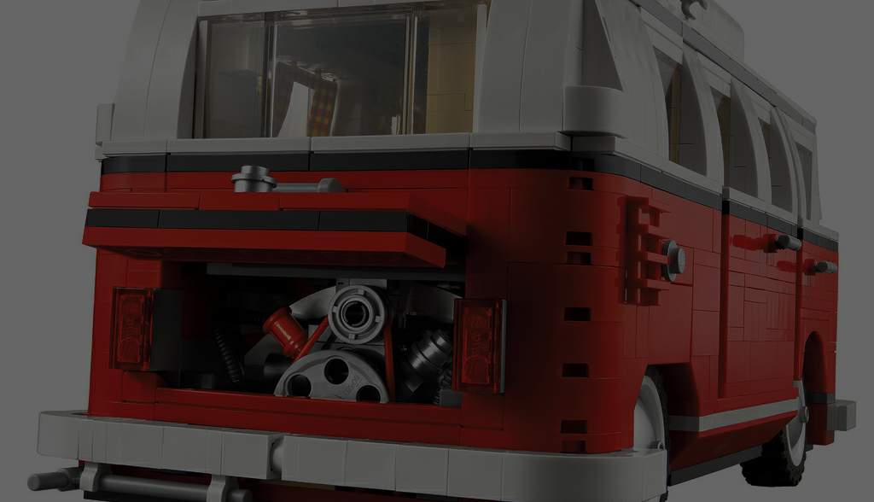
Flexible and Easy scale up
Function1
Function6
Function2
Service 2
Function5
Service 1
Function3
Function5
Function4
Function5
Service 3

Slide 9

Framework is like as jungle in road
Configuation
Configuation
Configuation
Configuation

Slide 10
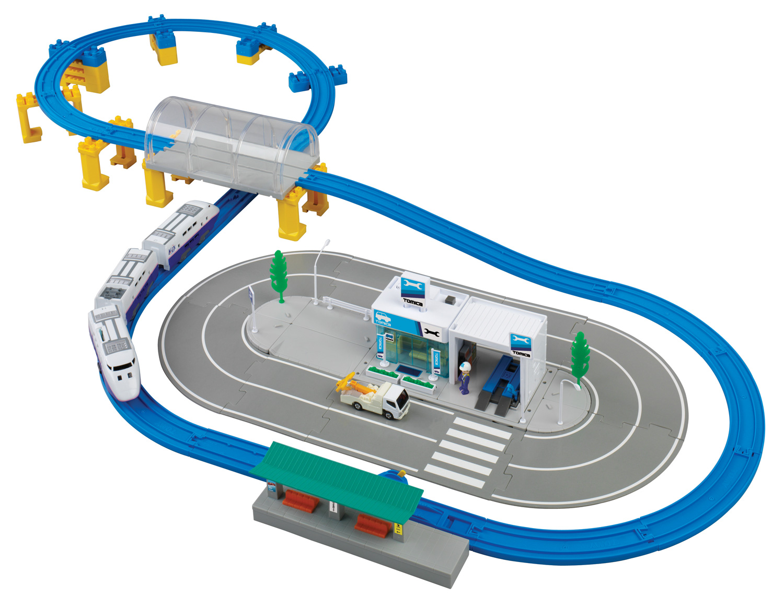
Let
Let
Let
Let
Let
Let
Let
Make easy part, also assemble easy all

Slide 11
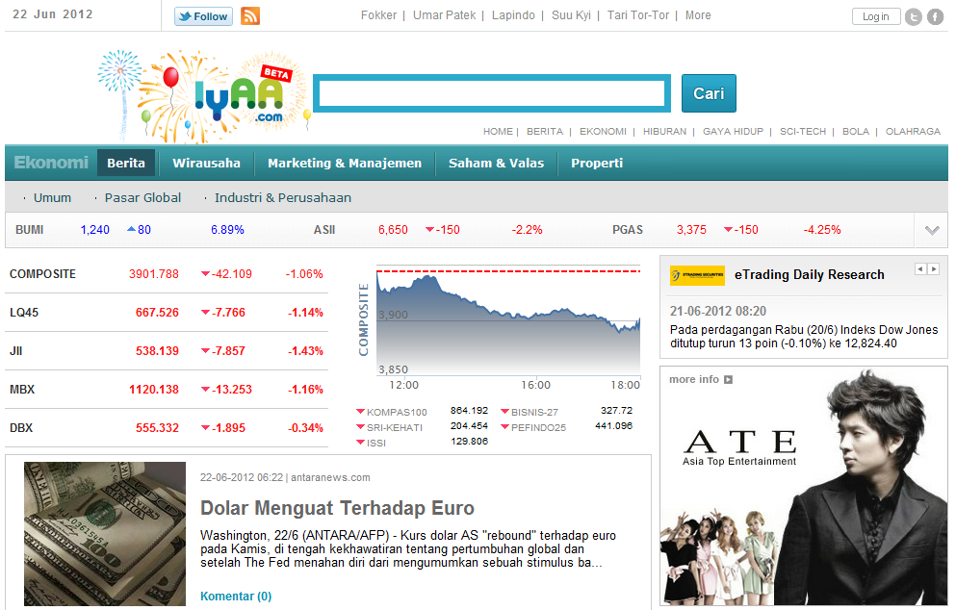
Fluffy
Alice
iii
Lake
Make easy part, also assemble easy all

Slide 12
Aradon…
void main(String[] args) to Service - Sample
http://www.iyaa.com/iii/crop/300x300/file/bola/foto/__icsFiles/afieldfile/2012/06/22/pc400.jpg
http://www.iyaa.com/iii/crop/200x300/file/bola/foto/__icsFiles/afieldfile/2012/06/22/pc400.jpg
http://www.iyaa.com/iii/crop/200x100/file/bola/foto/__icsFiles/afieldfile/2012/06/22/pc400.jpg

Slide 13
Thanks
gnic@i-on.net

